Slide 1
Autoscaling & Best Practices in Cloud Environments
Scalability In System Design

Slide 2
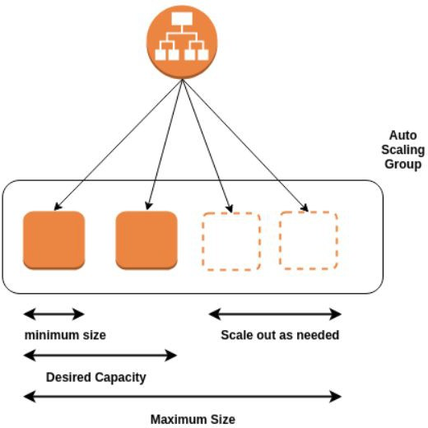
What is Autoscaling?
Autoscaling = automatic adjustment of compute resources based on load
Ensures performance, availability, and cost-eﬃciency
Common in microservices, web apps, and event-driven systems

Slide 3
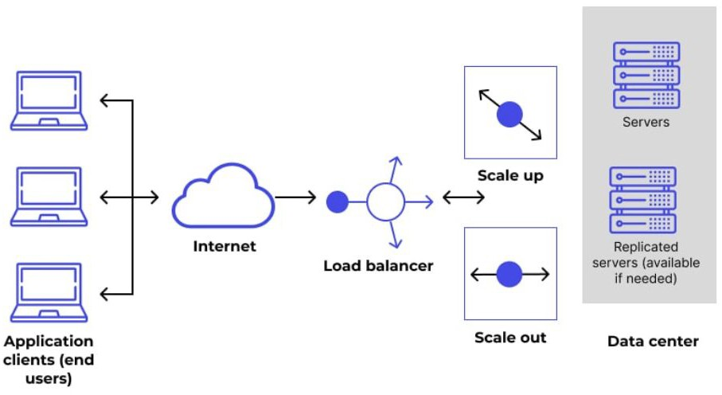
How Autoscaling Works
Triggers:
  CPU usage
  Memory
  Request rate
  Queue length
Types:
  Horizontal Scaling: Add/remove instances
  Vertical Scaling: Resize a single instance
Scaling Policies:
  Reactive (based on thresholds)
  Predictive (based on trends)

Slide 4

Autoscaling Across Cloud Providers
All major cloud providers support built-in autoscaling across compute and container services.
  AWS – Auto Scaling for EC2, Lambda, ECS, EKS
  Azure – Autoscaling via VM Scale Sets, App Services, AKS
  GCP – Autoscaling with MIGs, Cloud Run, GKE, Functions

Slide 5
Monitoring & Proactive Scaling
Use metrics like:
  CPU, Memory, Network
  Queue depth, Custom KPIs
Proactive Scaling:
  Predictive algorithms (based on ML or trends)
  Scheduled scaling (known traﬃc patterns)
Tools: CloudWatch, Prometheus + Grafana, Azure Monitor, GCP Operations

Slide 6
Cost Optimization Strategies
Avoid over-provisioning—scale just enough
Use spot/preemptible instances for batch workloads
Apply resource limits & quotas
Rightsize regularly based on actual usage
Use auto-pausing or scale-to-zero features for idle services

Slide 7
Interview Questions
Conceptual Understanding
  What is autoscaling, and why is it important in distributed systems?
  What’s the diﬀerence between horizontal and vertical scaling?
  How does predictive autoscaling work?
Cloud-Speciﬁc Scenarios
  How does autoscaling work in AWS/Azure/GCP?
  How would you set up autoscaling for a containerized application?
  What metrics would you monitor for eﬀective autoscaling?
Best Practices
  How can you ensure cost optimization when implementing autoscaling?
  What are some challenges with autoscaling in real-time systems?

Slide 8
Summary and Key Takeaways
Autoscaling ensures agility, availability, and cost-eﬃciency
Choose the right scaling strategy (horizontal, vertical, predictive)
Monitor proactively to stay ahead of load
Align autoscaling with cost goals and traﬃc patterns
What’s next:
  Summary and recap - Scalability in system design

Slide 9

Section Summary - Scalability in System Design
In this section, we explored the core building blocks of scalability in modern systems:
  Introduction to Scalability – Why systems need to scale and the challenges that come with it
  Scaling Strategies – Deep dive into Horizontal, Vertical, and Diagonal scaling approaches
  Load Balancing – How diﬀerent types of load balancers and algorithms distribute traﬃc eﬃciently
  Autoscaling – Best practices and how cloud platforms like AWS, Azure, and GCP support autoscaling
What’s Next:
  Database and Storage

